Slide 1
Drought Analysis
In West Coast (California, Washington)
Ann Polyakov
Chenxi Di
Nan Tang
Yusha Wang

Slide 2
Introduction
Definition of Drought:
A prolonged period of abnormally low rainfall, leading to a shortage of water.
Current Status:
California has been subject to substantial drought, leading to increased risk of forest fires and additional need for agricultural water. (conclusions from many articles)

Slide 3
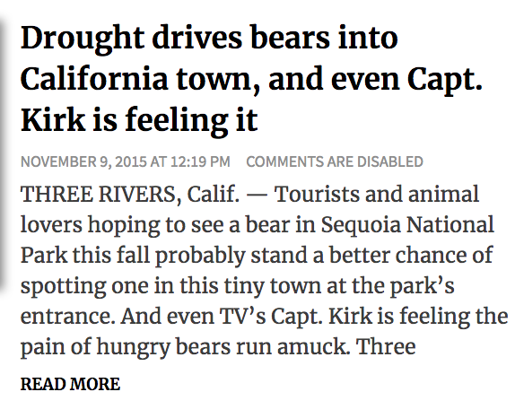

Introduction
Despite recent storm, California's 'drought map' depicts same bleak outlook
-----SFGATE Article

Slide 4
Question We Want to Ask :
Q1: Looking at long-term data on the Palmer drought severity index, is there a strong indication that droughts are getting worse over time in California and Washington state ?
Q2: Looking at long-term data on Precipitation, is there a increasing or decreasing precipitation trend over time in California and Washington state ?
Q3: Is there a correlation between Drought and Precipitation in California and Washington state ?

Slide 5
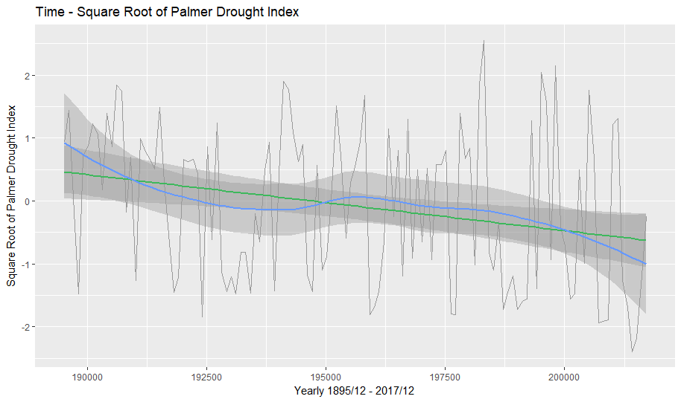
Drought Getting Worse over time? (CA)
Drought Getting Worse Over Time? (CA）
The Palmer Drought Severity Index (PDSI) uses available temperature and precipitation to estimate relative dryness.
-10 (driest) ~ 10 (wettest)

Slide 6
More Realistic Approach -- Time Series Model
Could try to fit a regular regression, but this does not take into account that values are auto-correlated (drought more likely next year if there was drought this year).
Decompose Data
Does series appear to have trends or seasonality?
stl() test
Stationarity
Is series stationary? (Constant mean value over time)
ADF test / KPSS test
Fit an ARIMA Model with regression
ARIMA(p,d,q), Auto regressive(p), degree of difference in Integrated(d), Moving average(q)
Future Trend Prediction
Notes:
Auto Regressive(p) refer to the use of past values in the regression equation for series. (d) represents degree of differencing in integrated component, subtracting its current value and precious values (d) times. Moving average(q) represents error of model a combination of previous error terms.

Slide 7
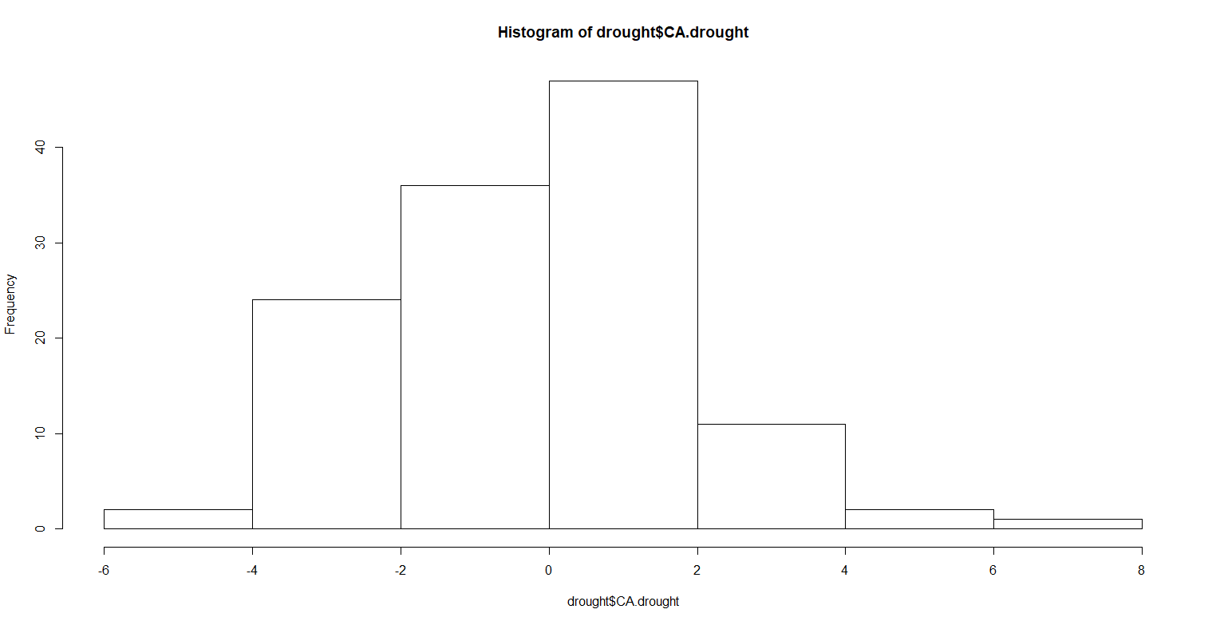
Step 1: Looking at distribution of data
Data collected from NOAA, Palmer drought severity index in CA (1895 - 2017)

Slide 8
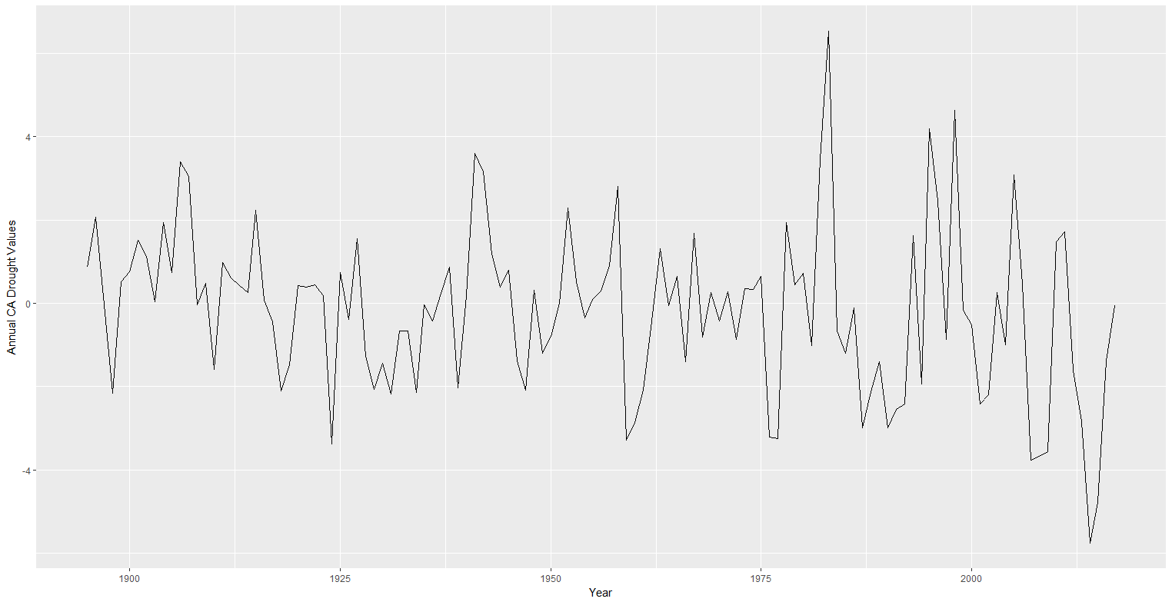
Step 2: Use ts() to create a time series object to pass to tsclean() to replace outlier by series smoothing

Slide 9
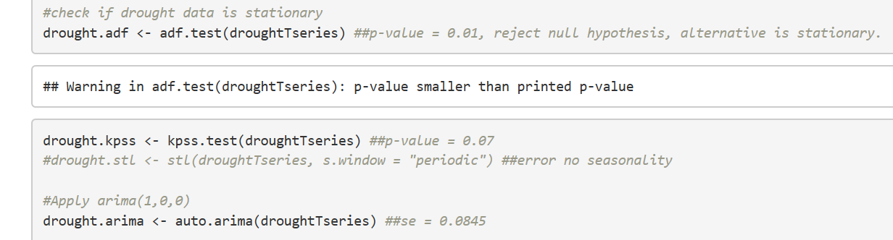
Step 3: Check stationary and detect seasonality or trend
ADF test: null = not stationary, p-value < 0.01, reject null.
KPSS test: null = stationary, p-value = 0.07, unable to reject null.
STL test: #error, no detected seasonality.
Stationarity: This time series is stationary.
Notes:
????? Use or not ?????

Slide 10
Step 4: Fit ARIMA model yields ARIMA(0,0,1) or MA(1) (one year lag error term)
> # fit an arima model
> fit <- auto.arima(drought$CA.drought,xreg=drought$Date)
> fit
Series: drought$CA.drought
Regression with ARIMA(0,0,1) errors
Coefficients:
ma1 xreg Pr(>|z|)
0.3033 -0.0124 0.0003752
s.e. 0.0853 0.0061 0.051
sigma^2 estimated as 3.436: log likelihood=-249.48
AIC=504.96 AICc=505.16 BIC=513.39

Slide 11
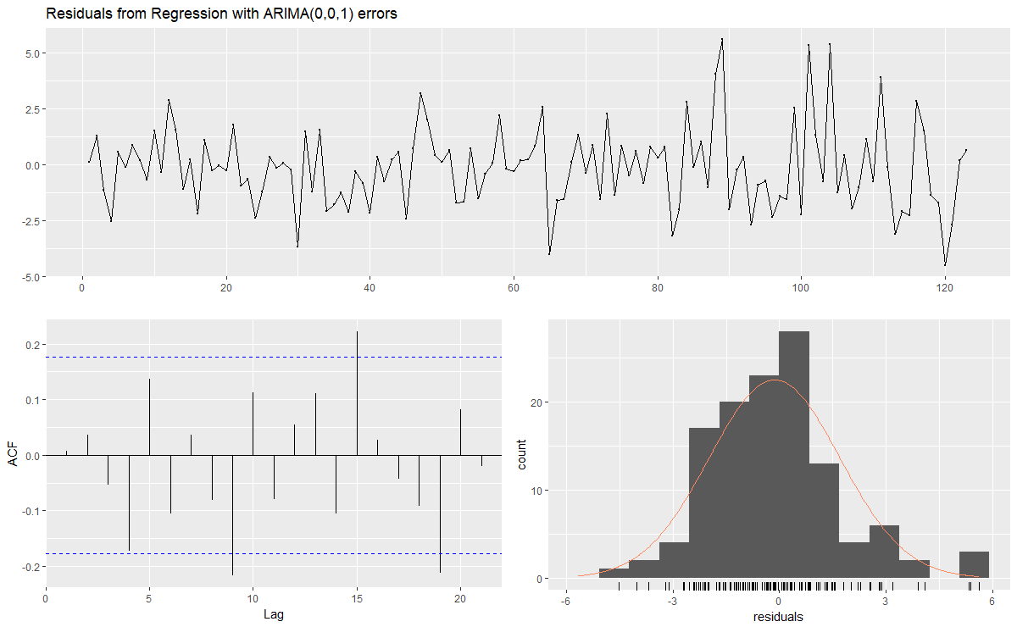
Check model goodness of fit

Slide 12
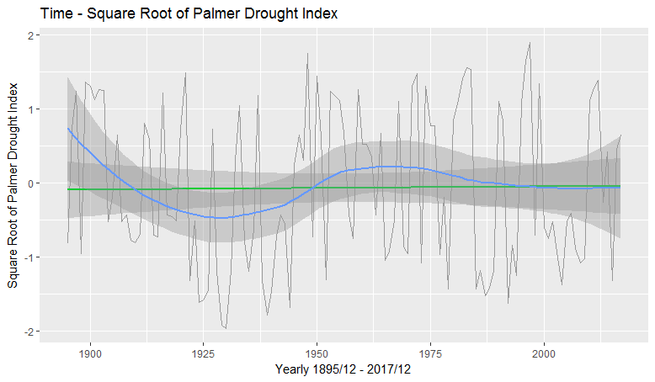
Drought Getting Worse over time? (CA)
Drought Getting Worse Over Time? (WA）
The Palmer Drought Severity Index (PDSI) uses available temperature and precipitation to estimate relative dryness.
-10 (driest) ~ 10 (wettest)

Slide 13
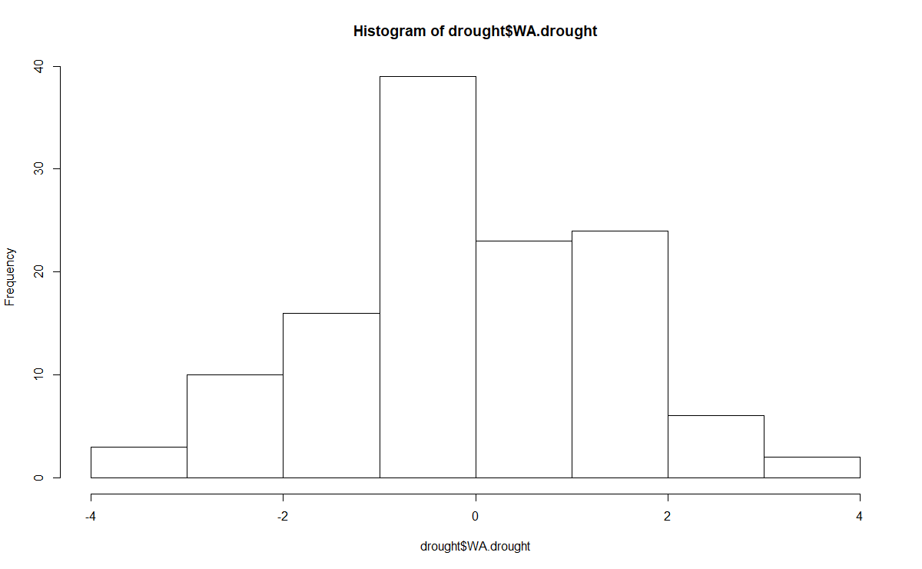
Step 1: Looking at distribution of data
Data collected from NOAA, Palmer drought severity index in WA (1895 - 2017)

Slide 14
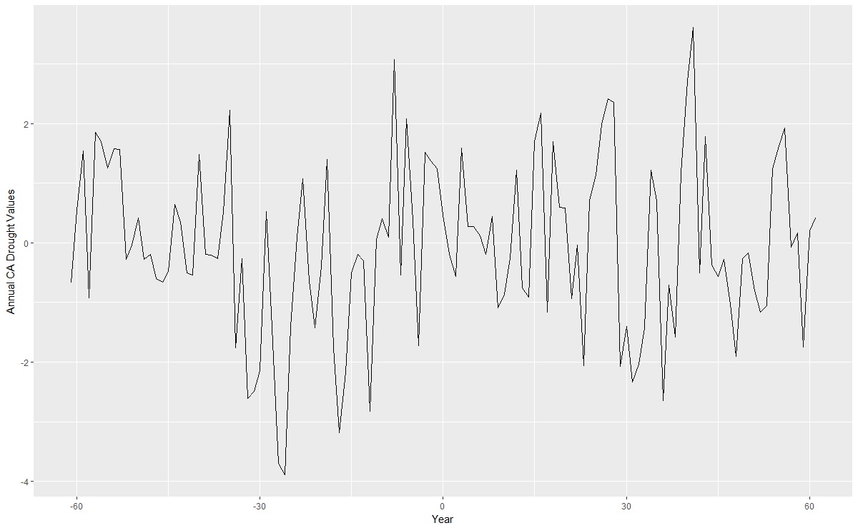
Step 2: Use ts() to replace outlier by series smoothing

Slide 15
Step 3: Check model stationary and detect seasonality or trend
ADF test: null = not stationary, p-value < 0.01, reject null.
KPSS test: null = stationary, p-value = 0.1, unable to reject null.
STL test: #error, no detected seasonality.
Stationarity: This time series is stationary.
Notes:
????? Use or not ?????

Slide 16
Step 4: Fit ARIMA model yields ARIMA(1,0,0) or AR(1) (negative lag 1 autocorrelation)
> # fit an arima model
> fit <- auto.arima(drought$WA.drought,xreg=drought$Date)
> fit
Series: drought$WA.drought
Regression with ARIMA(1,0,0) errors
Coefficients:
ar1 xreg Pr(>|z|)
0.3421 0.0015 4.92e-05
s.e. 0.0843 0.0051 0.77
sigma^2 estimated as 1.846: log likelihood=-211.28
AIC=428.55 AICc=428.76 BIC=436.99

Slide 17
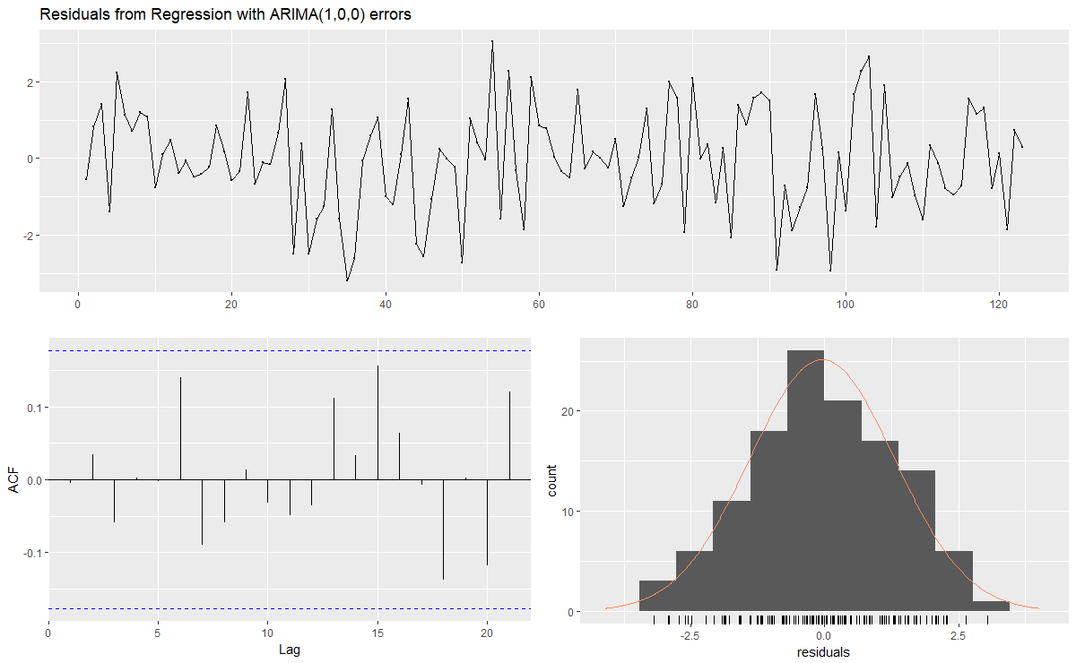
Check model goodness of fit

Slide 18
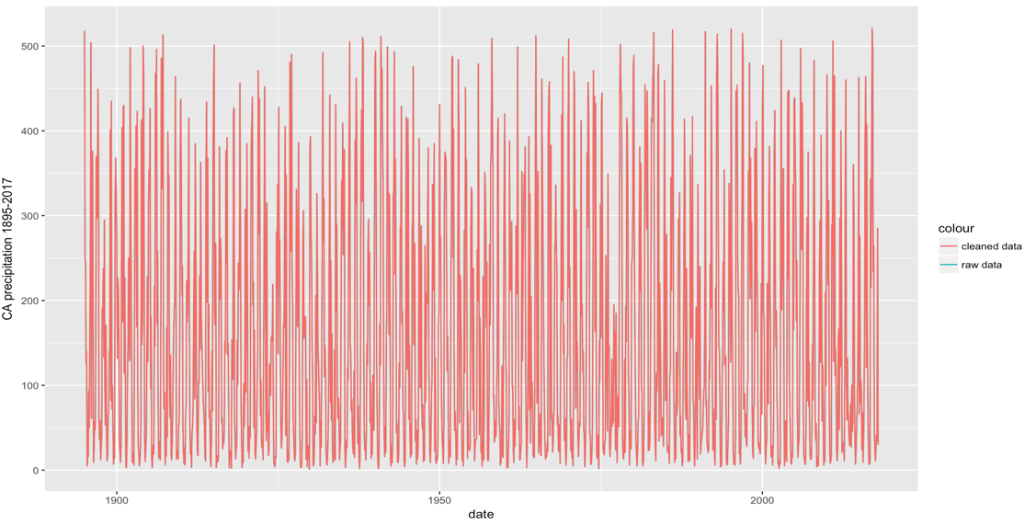
Is there substantial precipitation change in CA?
CA Precipitation Change from 1895 to 2017

Slide 19
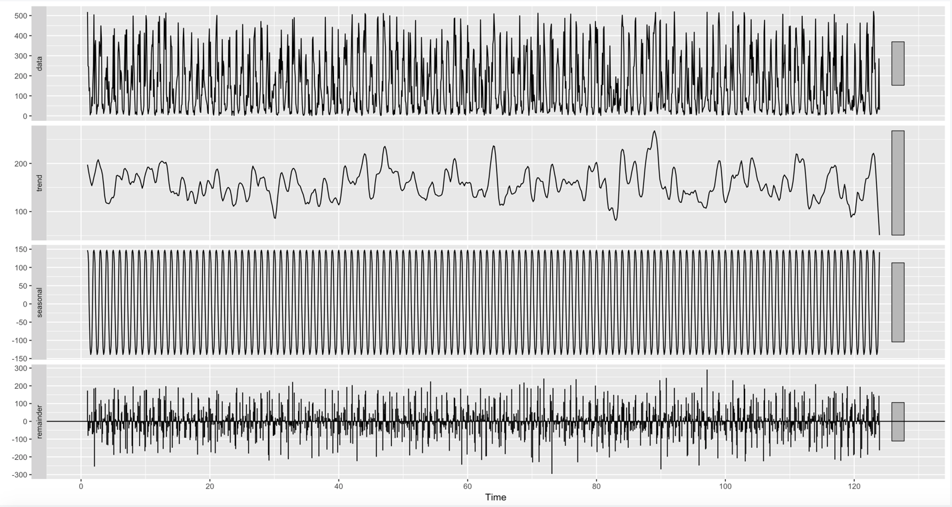
De-seasonalized Precipitation in CA stl() seasdj()
data
Time Series Decomposition
Additive Model = Seasonal +Trend + reminder
trend
seasonality
reminder
Notes:
We split the precipitation time series into three components: the underlying trend(by smoothing the time series used “centred moving average”), seasonality and random(the residual of the original data after seasonality and trend are removed)

Slide 20
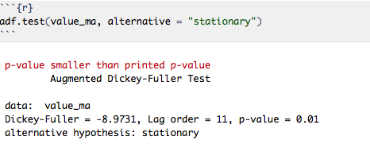
ADF Test: determine whether time series stationary
Null Hypothesis: “The time series is not stationary”
Alternative Hypothesis: “the time series is stationary”
Stationary Time Series: Precipitation mean, variance are time invariant.
We did not find substantial precipitation increase/decrease in CA over time.
Notes:
To use ARIMA Model, we need to first examine whether the series is stationary. We use ADF, aka Augmented Dickey-Fuller Test, to determine that.

Slide 21
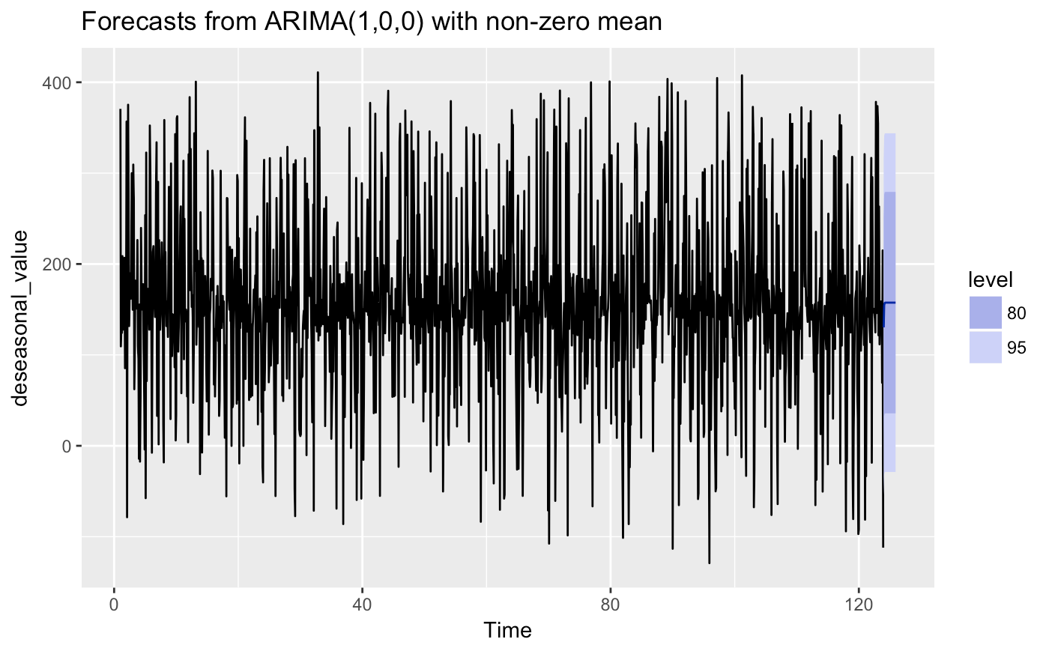
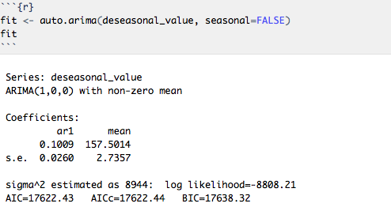
ARIMA Model and Forecast in CA

Slide 22

Is there substantial precipitation change in WA?
WA Precipitation Change from 1895 to 2017

Slide 23
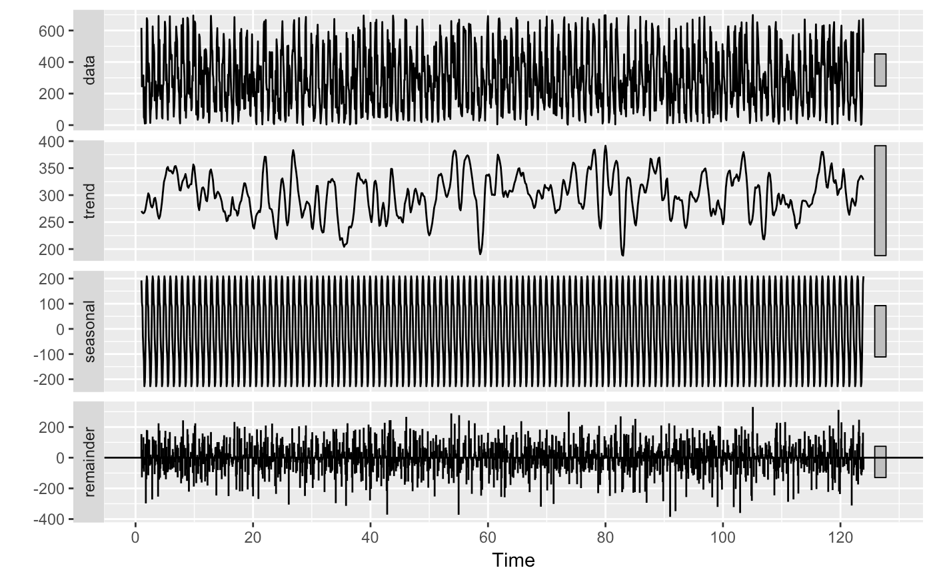
De-seasonalized Precipitation in WA stl() seasdj()
data
Time Series Decomposition
Additive Model = Seasonal +Trend + reminder
trend
seasonality
reminder
Notes:
We split the precipitation time series into three components: the underlying trend(by smoothing the time series used “centred moving average”), seasonality and random(the residual of the original data after seasonality and trend are removed)

Slide 24
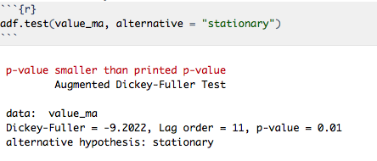
ADF Test: determine whether time series stationary
Null Hypothesis: “The time series is not stationary”
Alternative Hypothesis: “the time series is stationary”
Stationary Time Series: Precipitation mean, variance are time invariant.
We did not find substantial precipitation increase/decrease in WA over time.
Notes:
To use ARIMA Model, we need to first examine whether the series is stationary. We use ADF, aka Augmented Dickey-Fuller Test, to determine that.

Slide 25
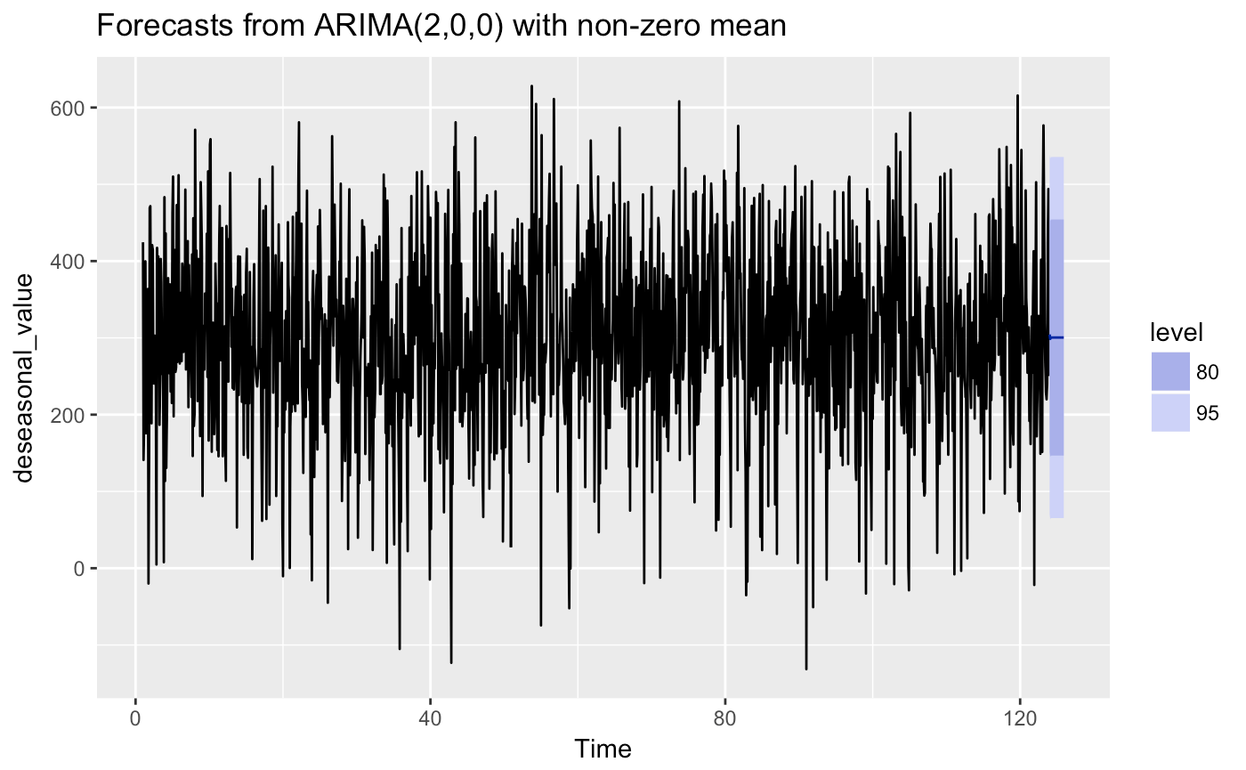
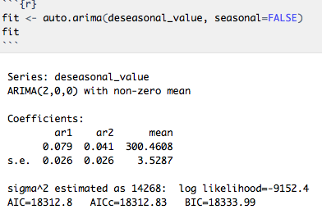
ARIMA Model and Forecast in WA
Notes:
For precipitation in WA, we get (2, 0, 0) arima model, which means the precipitation in each month depends on last month and the month before last month.

Slide 26
Is there any correlation between
Drought and Precipitation?
Compare drought and precipitation time series for CA
Compare drought and precipitation time series for WA

Slide 27
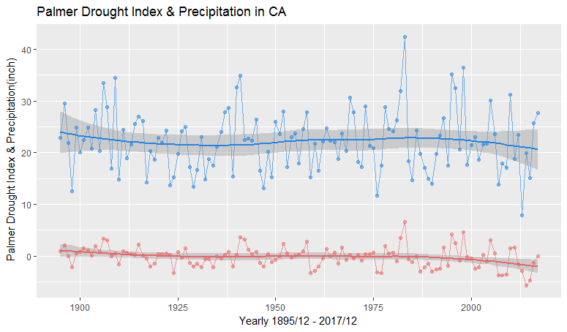
Raw Data on Drought index and Precipitation in CA
Precipitation in blue
Drought in red
Notes:
This is a method for fitting a smooth curve between two variables versus year.The fitted points and their standard errors represent are estimated with respect to the whole curve rather than a particular estimate. So, the overall uncertainty is measured as how well the estimated curve fits the population curve

Slide 28

Raw Data on Drought index and Precipitation in CA
Blue Slope:
-0.001386
Red Slope:
-0.012539

Slide 29
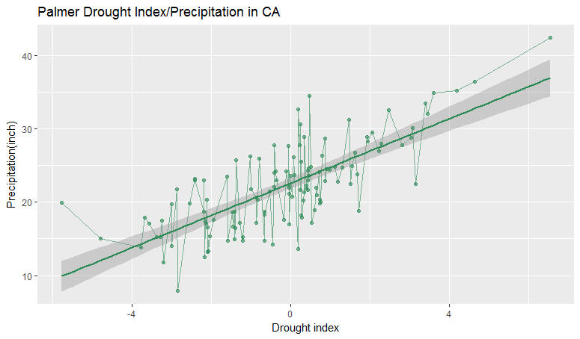
Correlation between CA Drought and Precipitation
Pearson's product-moment correlation:
0.7407377

Slide 30
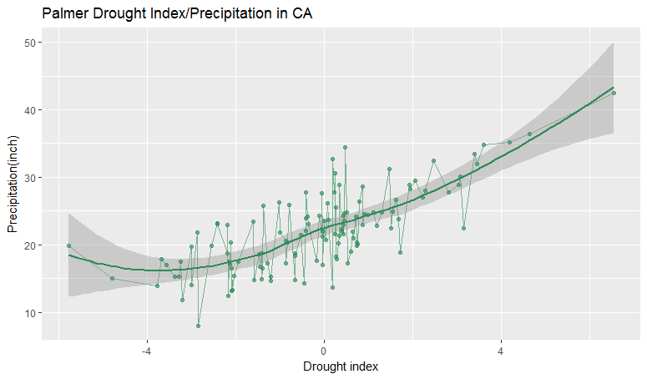
Correlation between CA Drought and Precipitation
Distance correlation:
0.6893273
Notes:
Pearson correlation: strength of the linear relationship between two variables
Distance correlation: distance correlation measures both linear and nonlinear association between two random variables or random vectors. Distance correlation coefficient is zero if and only if the random vectors are independent.

Slide 31
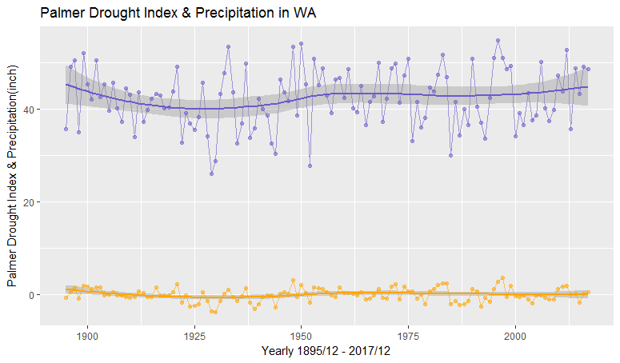
Raw Data on Drought index and Precipitation in WA
Purple: Precipitation
Orange: Drought

Slide 32
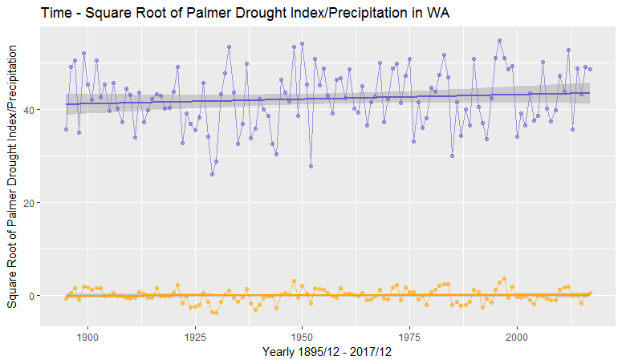
Raw Data on Drought index and Precipitation in WA
Purple Slope:
0.01973
Orange Slope:
0.001294

Slide 33
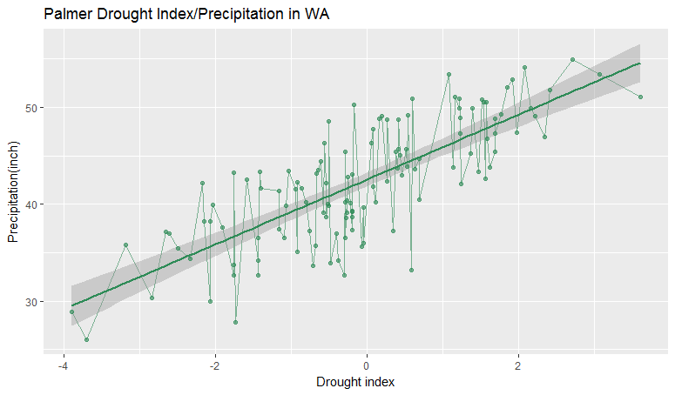
Correlation between WA Drought and Precipitation
Pearson's product-moment correlation:
0.7697111

Slide 34
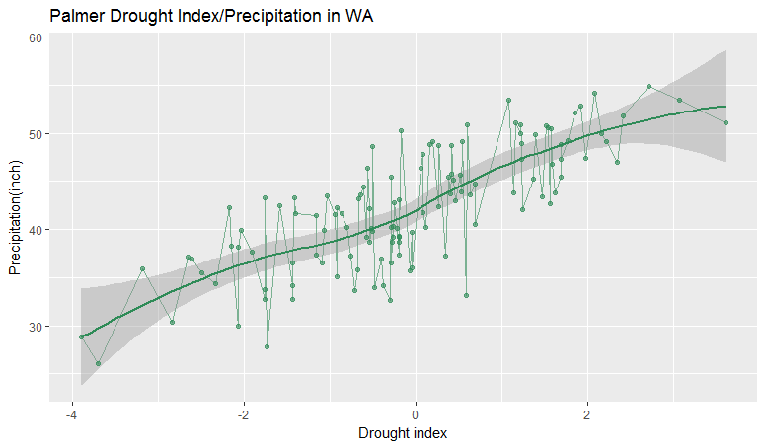
Correlation between WA Drought and Precipitation
Distance correlation:
0.7329371

Slide 35
Yes, drought and precipitation are correlated!!!

Slide 36
Is there a difference in Drought & Precipitation between California and Washington state ?
Method: Permutation test
(a)Look at Drought
Null: Drought time series for CA and WA are the same
(b)Look at Precipitation
Null : Precipitation time series for CA and WA are the same

Slide 37
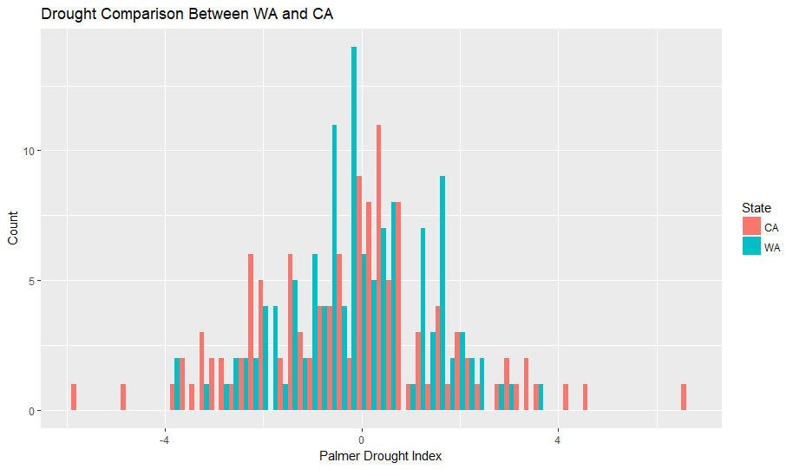
Seem to be similar?

Slide 38
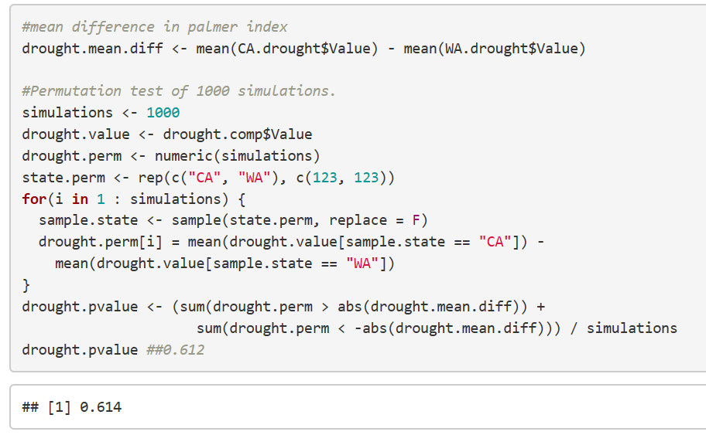
1000 simulations
Too big to reject
Drought patterns in CA and WA are not significantly different.

Slide 39
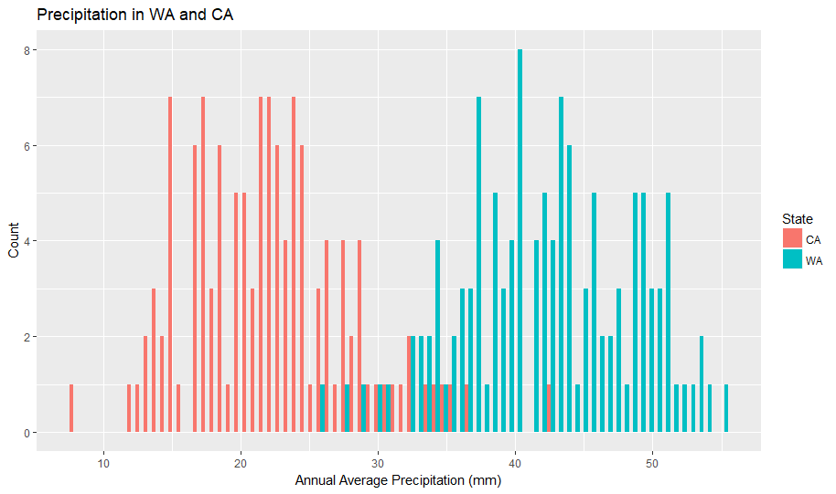
99.9999% sure they are different

Slide 40
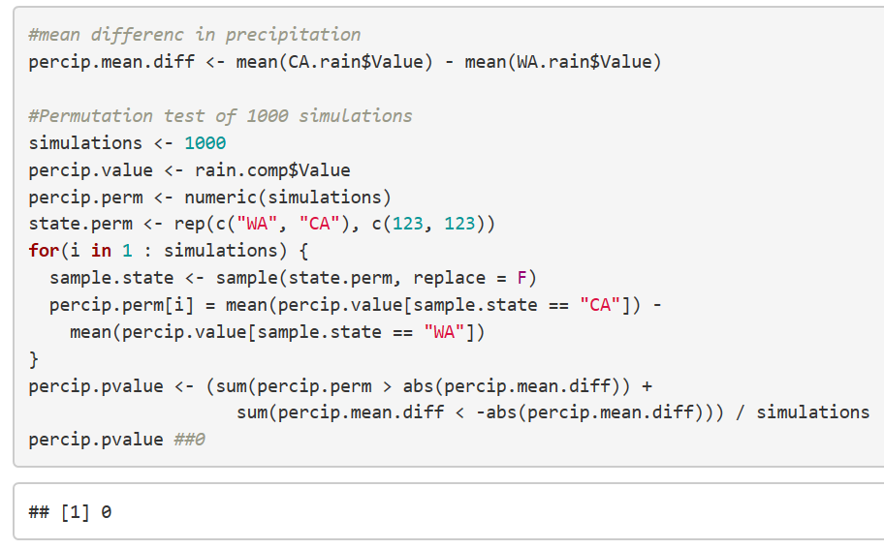
No more explanation. Reject it!!!

Slide 41
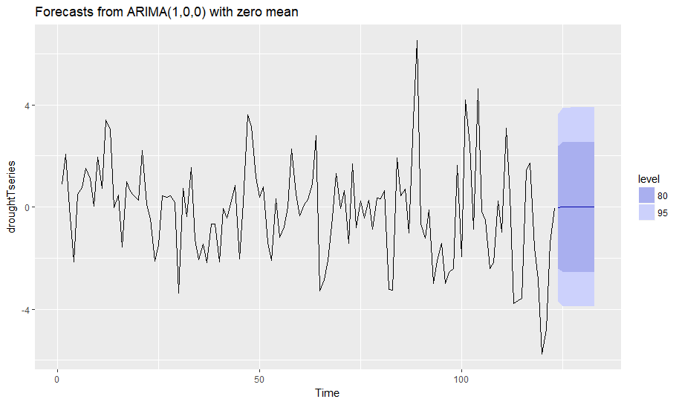
2005 - 2017

Slide 42
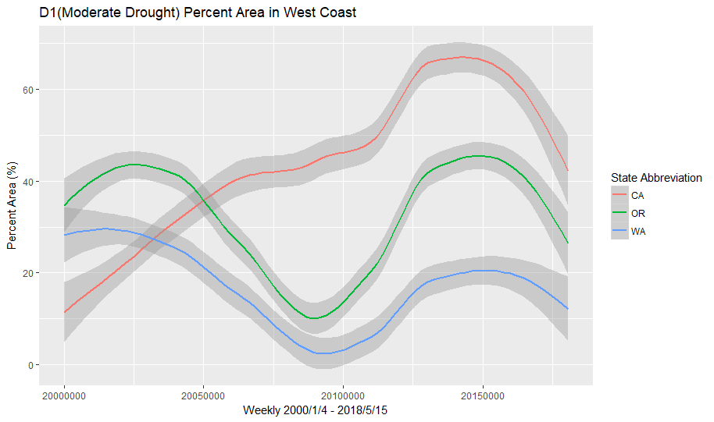
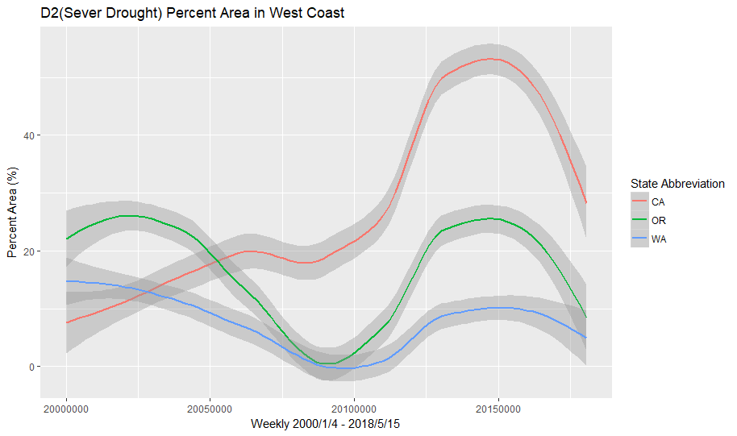
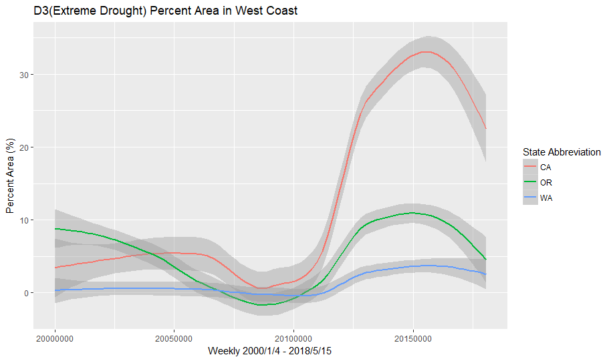
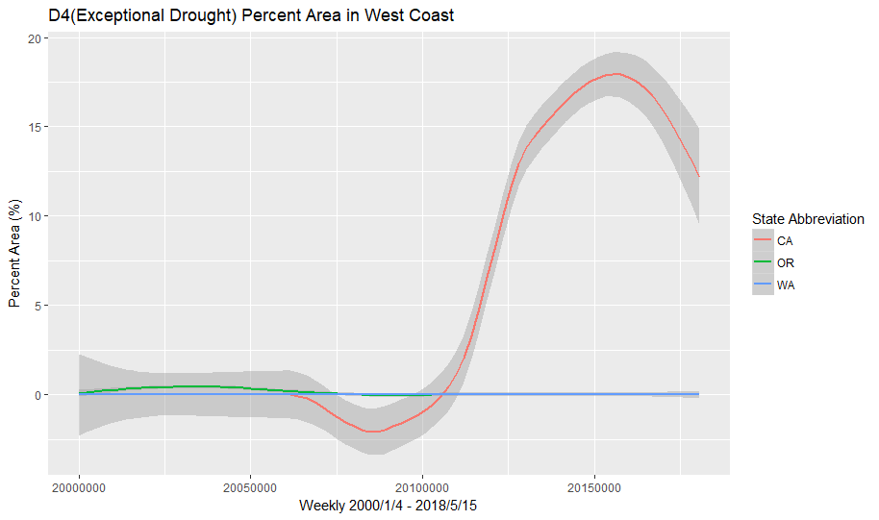
Explode since 2011
Percentage of areas impacted by levels of drought severity in CA, WA, OR.

Slide 43
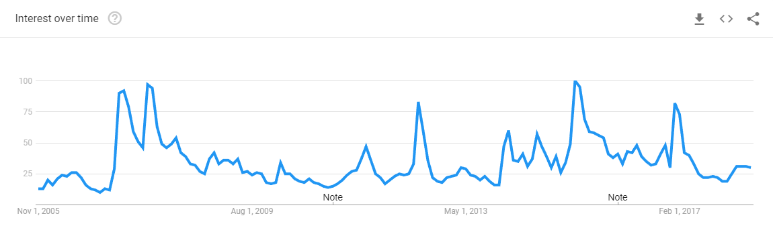
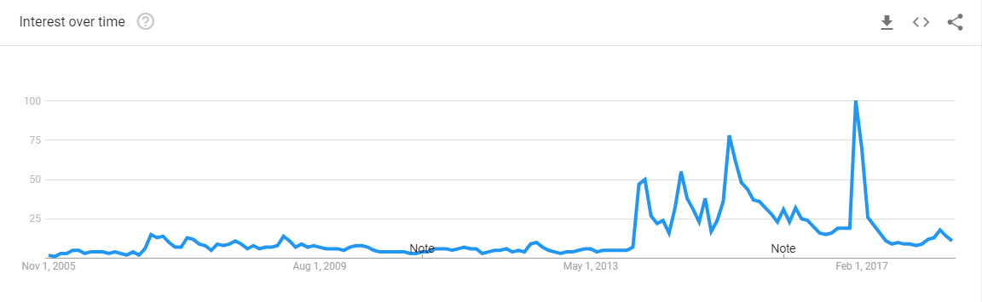
Peak search volume on “drought” fitted with recent explosion of drought severity.

Slide 44
Summary:
We did not detect either increasing or decreasing trend of precipitation in both CA and WA.
There is positive correlation between drought and precipitation in both California and Washington states.
Drought in CA and WA are not different.
Precipitation in CA and WA are different.
Exploded drought severity in CA since 2011.

Slide 45
Further research suggestion:
Looking at more locations in US
Examining monthly data or even weekly data
Fitting data on more complex models
Focusing on the frequency of extreme event

Slide 46
Reference
“United States Drought Monitor > Current Map > State Drought Monitor.” U.S. Drought Monitor, Eric Luebehusen, droughtmonitor.unl.edu/CurrentMap/StateDroughtMonitor.aspx?CA.
CMB.Contact@noaa.gov. “Temperature, Precipitation, and Drought.” National Climatic Data Center, www.ncdc.noaa.gov/temp-and-precip/.
Graff, Amy. “Despite Recent Storm, Californias Drought Map Depicts Same Bleak Outlook.” SFGate, San Francisco Chronicle, 8 Mar. 2018, www.sfgate.com/bayarea/article/California-drought-monitor-map-dry-storms-12738517.php.
Dalinina, Ruslana. “Introduction to Forecasting with ARIMA in R.” DataScience.com, DataScience.com Blog, www.datascience.com/blog/introduction-to-forecasting-with-arima-in-r-learn-data-science-tutorials.

